Slide 1
Introduction to Energy Systems
Module 2 & 3
Fossil Fuels and Combustion Cycle of Fossil Fuel Power Plants
Prepared by: Prof. Amin Ghobeity
Please do not distribute without permission

Slide 2


References
+ Instructor notes
Energy Systems Engineering: Evaluation and Implementation, 4th Ed.
McGraw-Hill, New York, 2016
Chapter 4 (Fossil Fuels) &
Chapter 5 (Stationary Combustion Cycles)
Thermodynamics: An Engineering Approach
Ninth Edition (2019),
Yunus Cengel and Michael Boles
McGraw-Hill, 2019

Slide 3
Learning Outcome
Introduction to fossil fuels, their applications, emissions and their characteristics
Describe the operating principles of conventional power plants.
  Rankine Cycle
  Brayton Cycle
  Combined Cycles
  Combined Heat and Power (CHP)
Demonstrate a working knowledge of the basic principles of combustion cycles.
Review basic thermodynamics principles and definitions required for analysis of stationary combustion cycles
Analyze conventional power plant thermodynamic cycles at system-level

Slide 4
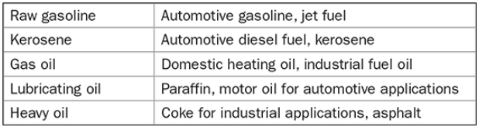
Conventional Fossil Fuels
Conventional Fossil Fuels:
  Coal
  Natural Gas
  Oil
Oil comes in the form of crude petroleum that must be refined into a range of end products.

Slide 5
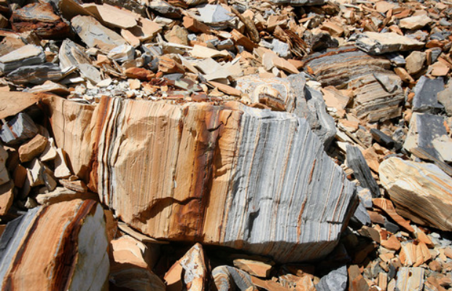
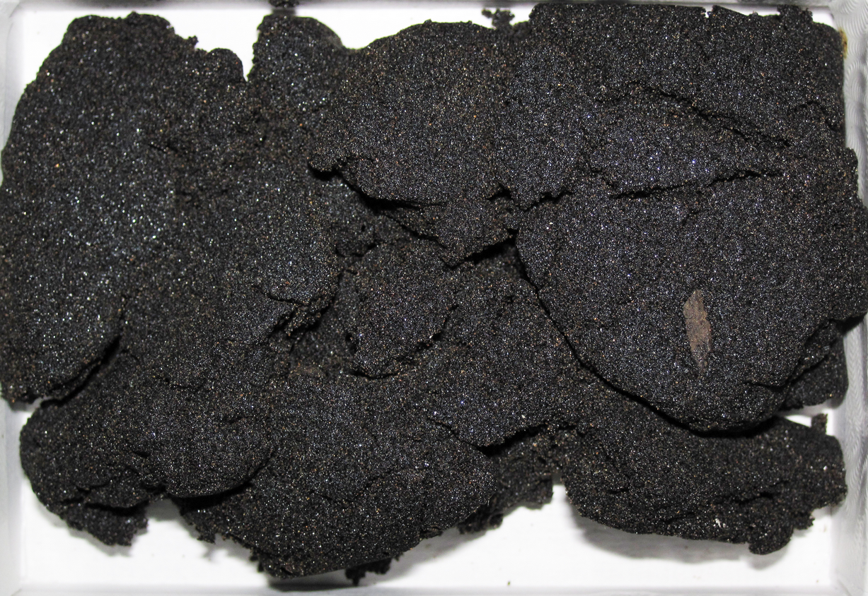
Nonconventional Fossil Fuels
Nonconventional Fossil Fuels:
  Shale Oil
    Oil trapped in sedimentary rocks
    Large resources: U.S. and Brazil
  Shale Gas
    Gas trapped between shale layers and previously inaccessible
    Accessed through hydro-fracturing (i.e. “fracking”)
  Tar Sands
    Mixture of sand with highly viscous hydrocarbon tar
    Large resources: Canada and Venezuela
  Synthetic Gas from Coal (i.e. “syngas”)
    Coal processed to produce a fuel gas mixture consisting primarily of hydrogen, carbon monoxide
The rock that burns: Is Utah about to see oil shale bonanza?
https://archive.sltrib.com/article.php?id=27763273&itype=storyID
Tar sand from Alberta, Canada.
https://commons.wikimedia.org/wiki/File:Athabasca_Tar_Sand_(near_Fort_McMurray,_Alberta,_Canada).jpg

Slide 6
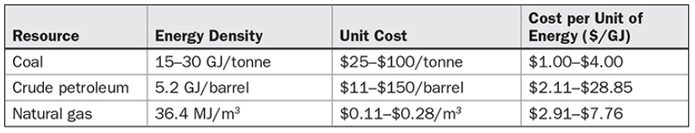
Fossil Fuel Cost & Energy Density
Coal is significantly cheaper, but much more difficult to transport and efficiently utilize. Actual price paid by the end user well above the values shown
Oil prices are very volatile
Coal varies the most in energy density. Relative moisture has significant effect on energy density
Observed trend: coal is being replaced with natural gas where natural gas reserves are available (“decarbonization”), e.g., Canada

Slide 7
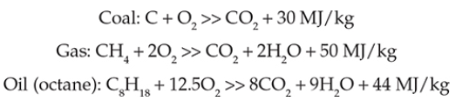
CO₂ Emission of Fossil Fuels
The CO₂ emissions per unit of fossil fuel combusted are a function of the chemical reaction of the fuel with oxygen
Fossil fuels that have a high ratio of hydrogen to carbon have a higher net energy value thanks to the nature of bonds formed and bonds broken, and so will release less CO₂ per unit of energy released.
Coal does not have any such bonds, so it has the lowest amount of energy released per unit of CO₂ emitted to the atmosphere.

Slide 8
Motivation
Fossil fuel component of world energy production, 2000 and 2012

Slide 9
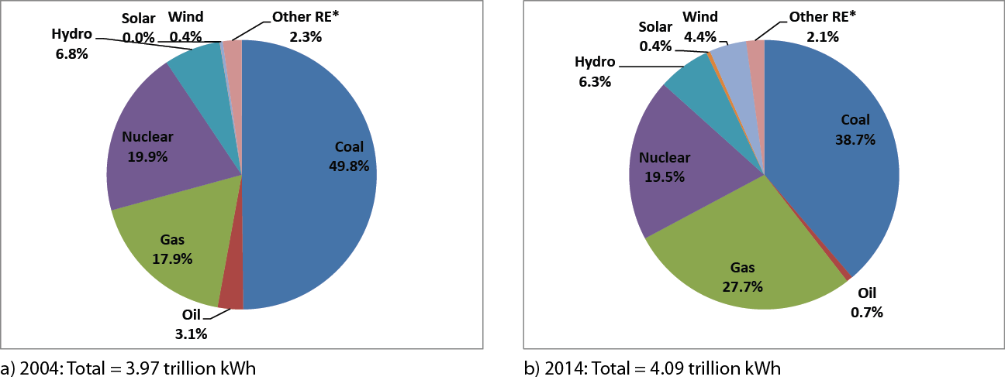
Motivation
U.S. Electricity Generation Mix, 2004 and 2014

Slide 10
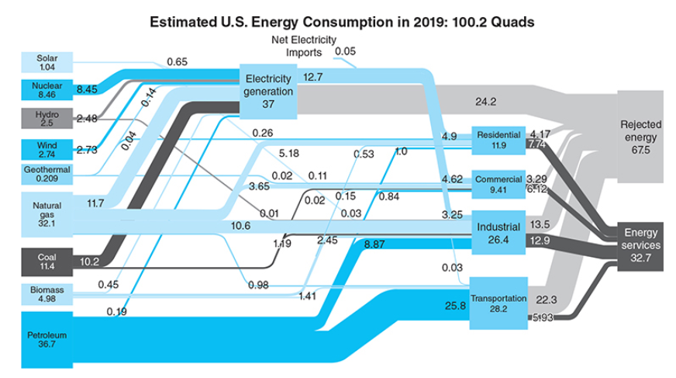
Fossil Fuel Use

Slide 11
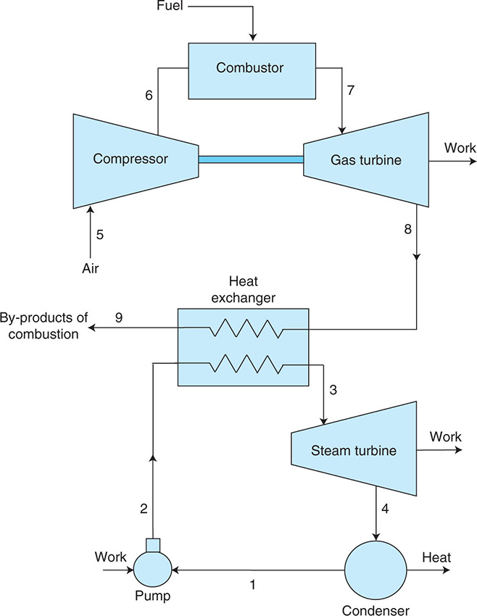
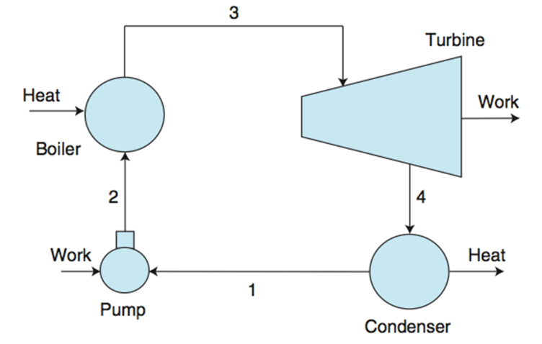
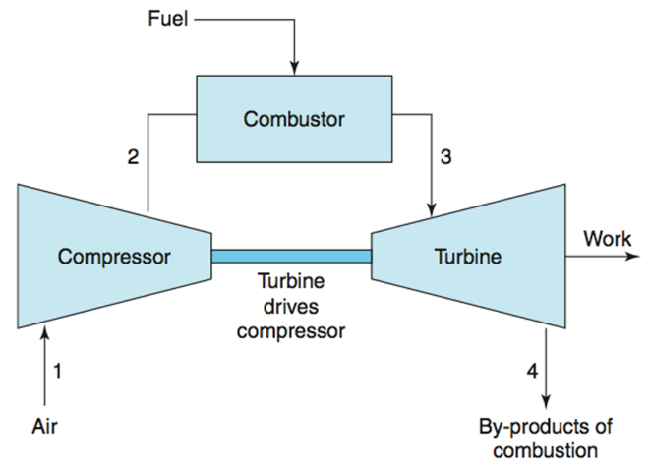
Goal
System-level analysis (energy balance, economic analysis, and emission calculations) of stationary combustion systems, namely Rankine (steam turbines), Brayton (gas turbines), and combined cycles
Rankine cycle Brayton cycle Combined Cycle
Analysis limited to simple cycles

Slide 12
PART 1
Introduction to Power Generation Cycles

Slide 13
Introducing Power Generation (1 of 3)
Power generation is primarily based on Rankine Cycles (simple Rankine, Renergerative Rankine, Reheat Rankine, etc.), Brayton Cycle, and Combined Cycles
Rankine: Steam Cycle;
Brayton: Gas Cycle;
Combined: Top Gas, Bottom Steam Cycle
Today we are heavily dependent on coal, natural gas, and nuclear, all of which are nonrenewable.
Nuclear power plant run on steam cycle too
Current U.S. Electricity Generation by Source
Natural gas | 33.8%
Coal | 30.4%
Nuclear | 19.5%
Hydroelectric (conventional) | 6.5%
Other renewables ª | 8.4%
Petroleum (total) | 0.6%
Others | 0.5%
ª Renewable sources including solar, excluding hydroelectric
Source: United States Energy Information Administration, 2016, Net Generation by Energy Source: Total (All Sectors) http://www.eia.gov/electricity/monthly/pdf/epm.pdf

Slide 14
Introducing Power Generation (2 of 3)
Power Plant Type | Nonrenewable Source | Renewable Source | Thermodynamic Cycle
Coal-fueled | Yes |  | Rankine
Natural gas–fueled | Yes |  | Brayton
Nuclear-fueled | Yes |  | Rankine
Oil-fueled | Yes |  | Rankine
Biomass-fueled |  | Yes | Rankine
Geothermal |  | Yes | Rankine
Solar-concentrating |  | Yes | Rankine
Hydroelectric |  | Yes | None
Wind |  | Yes | None
Solar-photovoltaic |  | Yes | None
Fuel cells | Yes |  | None
Currents, tides, and waves |  | Yes | None

Slide 15
Introducing Power Generation (3 of 3)
Thermodynamic cycles are a fundamental aspect of several power plant types that employ renewable or nonrenewable sources.
Vapor power systems and gas turbine power systems are studied as thermodynamic cycles.
In vapor power systems (i.e., steam cycles) water is alternately vaporized and condensed. The basic building block of vapor power systems is the Rankine cycle.
In gas power cycles, air is compressed, a combustion process adds heat to the compressed air, and combustion gases run a gas turbine. The basic building block of gas power systems is the Brayton cycle.
System-level analysis of steam and gas cycles employed for power generation through combustion of fossil fuels requires basic understanding of thermodynamic properties and thermodynamic cycles (Part 2 of this module)

Slide 16
Introducing Vapor Power Plants (1 of 11)
In the following slides the components of four alternative vapor power plant configurations are shown schematically. They are
  Fossil-fueled vapor power plants.
  Pressurized-water reactor nuclear vapor power plants.
  Concentrating solar thermal vapor power plants.
  Geothermal vapor power plants.
In each of the four types of vapor power plant, a working fluid is alternately vaporized and condensed. A key difference among the plants is the origin of the energy required to vaporize the working fluid.

Slide 17
Introducing Vapor Power Plants (2 of 11)
In fossil-fueled plants, the energy required for vaporization originates in combustion of the fuel.

Slide 18
Introducing Vapor Power Plants (3 of 11)
In nuclear plants, the energy required for vaporization originates in a controlled nuclear reaction.

Slide 19
Introducing Vapor Power Plants (4 of 11)
In solar plants, the energy required for vaporization originates in collected and concentrated solar radiation.

Slide 20
Introducing Vapor Power Plants (5 of 11)
In geothermal plants, the energy required for vaporization originates in hot water and/or steam drawn from below the earth’s surface.

Slide 21
Introducing Vapor Power Plants (6 of 11)
The fossil-fueled vapor power plant will be considered as representative. The overall plant is broken into four major subsystems identified by A, B, C, and D. Water is the working fluid.

Slide 22
Introducing Vapor Power Plants (7 of 11)
Subsystem A provides the thermal energy needed to vaporize water circulating in subsystem B. In fossil-fueled plants this heat transfer has its origin in the combustion of the fuel.

Slide 23
Introducing Vapor Power Plants (8 of 11)
In subsystem B, the water vapor expands through the turbine, developing power. The water then condenses and returns to the boiler.

Slide 24
Introducing Vapor Power Plants (9 of 11)
In subsystem C, mechanical power developed by the turbine drives an electric generator.

Slide 25
Introducing Vapor Power Plants (10 of 11)
Subsystem D removes thermal energy from the steam cycle by condensing steam in subsystem B.

Slide 26
Introducing Vapor Power Plants (11 of 11)
Each unit of mass of water periodically undergoes a thermodynamic cycle as it circulates through the components of subsystem B. This cycle is the Rankine cycle.

Slide 27
PART 2
Thermal Sciences
The science that deal with energy and the transfer, transport, and conversion of energy

Slide 28
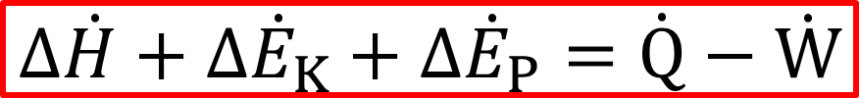
Energy Balances
Closed systems:
No mass crosses the system boundaries
Open systems:
Mass crosses the system boundaries
H : Enthalpy H = U + PV, measured in kJ

Slide 29
Approach
For water/steam ∆u and ∆h are found using thermodynamic property tables
For ideal gases (Air, Oxygen, Nitrogen, etc.) ∆u and ∆h may be approximated using specific heats (exact properties of some of these gases are provided in tables too).
  ∆u=C_{v}(T₂-T₁)
  ∆h= C_{p}(T₂-T₁)
For incompressible liquids and solids, ∆u= ∆h and found using specific heats ∆u= ∆h =C(T₂-T₁)

Slide 30
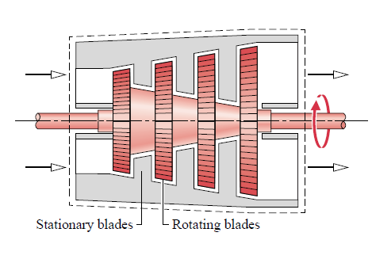
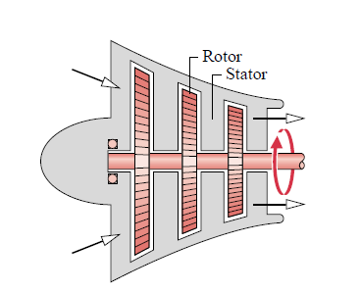
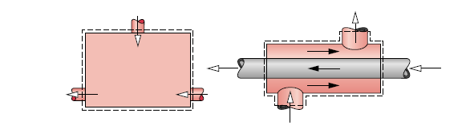
Open Systems
Turbines, Compressors, Heat Exchanger and Flow Mixers
A turbine is a device in which work is developed as a result of a gas or liquid passing through a set of blades attached to a shaft free to rotate
Compressors are devices in which work is done on a gas passing through them in order to
raise the pressure
Devices that transfer energy between fluids at different temperatures by heat transfer are called heat exchangers.
One common type of heat exchanger is a vessel in which hot and cold streams are mixed directly (Left). An open feedwater heater is an example of this type of device.
Another common type of heat exchanger is one in which a gas or liquid is separated from another gas or liquid by a wall through which energy is conducted. (Right)

Slide 31
Turbine Modeling (Air and Water)
If the change in kinetic energy of flowing matter is negligible, ½(V₁² – V₂²) drops out.
If the change in potential energy of flowing matter is negligible, g(z₁ – z₂) drops out.
If the heat transfer with surroundings is negligible,
drops out.
Positive work – Turbine produces work

Slide 32
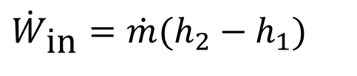
Compressor Modeling (Air Only)
If the change in kinetic energy of flowing matter is negligible, ½(V₁² – V₂²) drops out.
If the change in potential energy of flowing matter is negligible, g(z₁ – z₂) drops out.
If the heat transfer with surroundings is negligible,
drops out.
compressor receives work
$${\dot{W}}_{\text{in}}=\dot{m}(h_{2}−h_{1})$$

Slide 33
Heat Exchanger Modeling
(Eq. 4.18)
If the kinetic energies of the flowing streams are negligible, (V_{i}²/2) and (V_{e}²/2) drop out.
If the potential energies of the flowing streams are negligible, gz_{i} and gz_{e} drop out.
If the heat transfer with surroundings is negligible,
drops out.
►

Slide 34
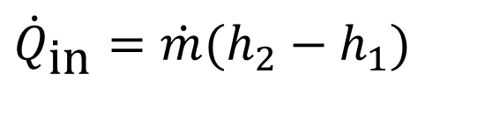
Boiler/Condenser Modeling (Water)
If the kinetic energies of the flowing streams are negligible, (V_{i}²/2) and (V_{e}²/2) drop out.
If the potential energies of the flowing streams are negligible, gz_{i} and gz_{e} drop out.
►
$${\dot{Q}}_{\text{in}}=\dot{m}(h_{2}−h_{1})$$

Slide 35
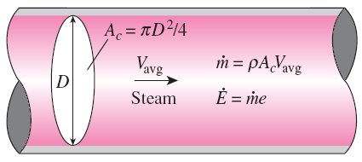
ENERGY FLOW RATE
Mass flow rate
Energy flow rate

Slide 36
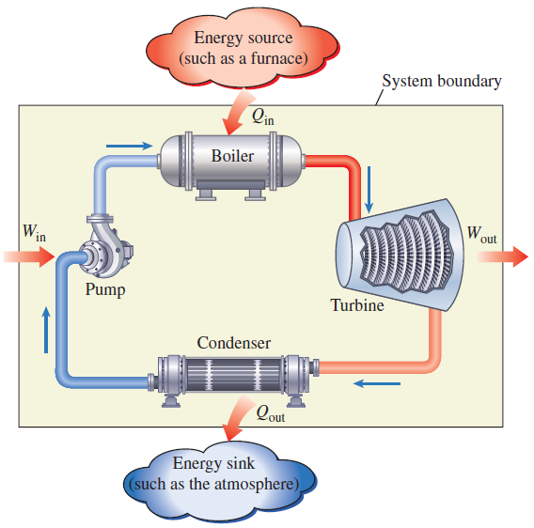


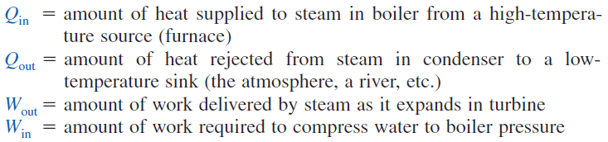
A steam power plant (Rankine cycle)

Slide 37
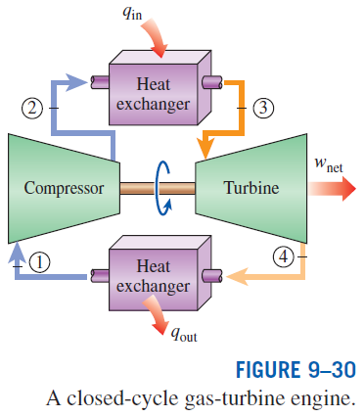
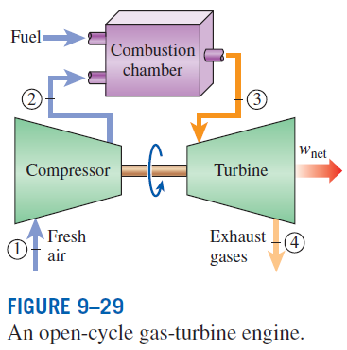
A gas power plant (Brayton cycle)

Slide 38

Overall Plant Efficiency
The overall plant efficiency can be used to express the performance of all power plants which burn a fuel such as steam power plants, gas-turbine power plants, and automobile engines.
Thermal efficiency and overall plant efficiency are sometimes used interchangeably.
This number is as high as 40% for large gas-turbine plants and as high as 60% for large combined gas-steam power plants.

Slide 39
PART 3
GAS POWER CYCLES
BRAYTON CYCLE

Slide 40
BRAYTON CYCLE: THE IDEAL CYCLE FOR GAS-TURBINE ENGINES
The combustion process is replaced by a constant-pressure heat-addition process from an external source, and the exhaust process is replaced by a constant-pressure heat-rejection process to the ambient air.
1-2 Isentropic compression (in a compressor)
2-3 Constant-pressure heat addition
3-4 Isentropic expansion (in a turbine)
4-1 Constant-pressure heat rejection

Slide 41
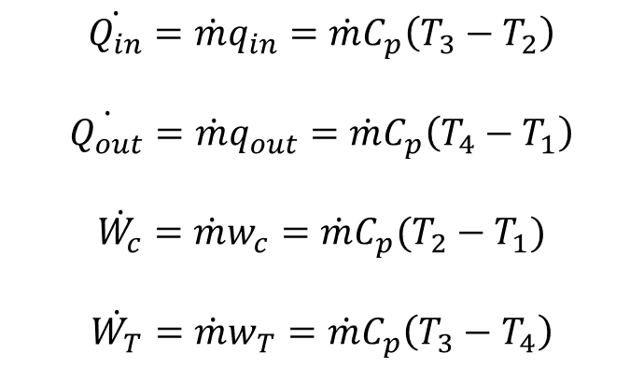
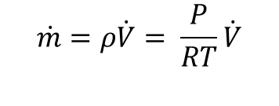
Brayton Cycle Calculations
$$\dot{Q_{in}}=\dot{m}q_{in}={\dot{m}C}_{p}\left(T_{3}−T_{2}\right)$$
$$\dot{Q_{out}}=\dot{m}q_{out}={\dot{m}C}_{p}\left(T_{4}−T_{1}\right)$$
$$\dot{W_{c}}=\dot{m}w_{c}={\dot{m}C}_{p}(T_{2}−T_{1})$$
$$\dot{W_{T}}=\dot{m}w_{T}={\dot{m}C}_{p}\left(T_{3}−T_{4}\right)$$
$$\dot{m}=ρ\dot{V}= \frac{P}{RT}\dot{V}$$

Slide 42


ISENTROPIC RELATIONS (Turbine / Compressor)
k is the specific heat ratio and can be assumed 1.4 for air
p₂/p₁ is the pressure ratio (turbine/compressor)
Absolute temperature (K or R) must be used in these rations
Pressure ratio

Slide 43
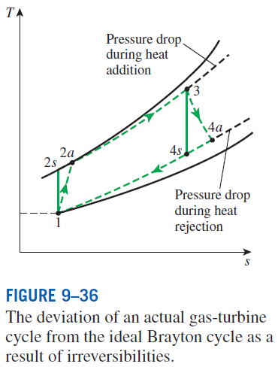
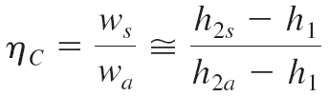
ACTUAL GAS TURBINE
Increasing the turbine inlet (or firing) temperatures
Increasing the efficiencies of turbomachinery components (turbines, compressors):
Adding modifications to the basic cycle (intercooling, regeneration or recuperation, and reheating).
Deviation of Actual Gas-Turbine Cycles from Idealized Ones
Reasons: Irreversibilities in turbine and compressors, pressure drops, heat losses
Isentropic efficiencies of the compressor and turbine

Slide 44
PART 4
STEAM POWER CYCLES
&
COMBINES CYCLES

Slide 45
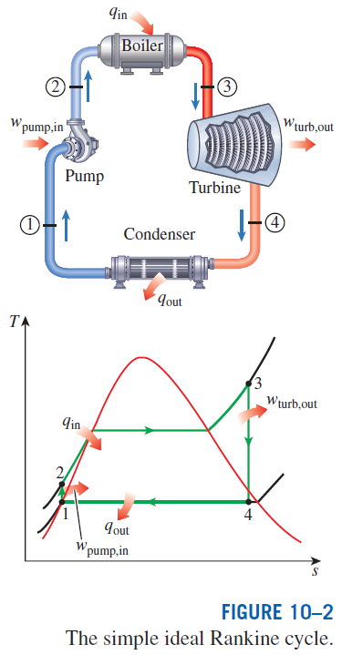
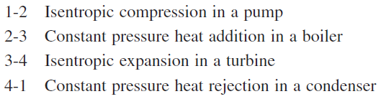
RANKINE CYCLE: THE IDEAL CYCLE FOR STEAM TURBINES
Many of the impracticalities associated with the Carnot cycle can be eliminated by superheating the steam in the boiler and condensing it completely in the condenser.
The cycle that results is the Rankine cycle, which is the ideal cycle for vapor power plants.

Slide 46
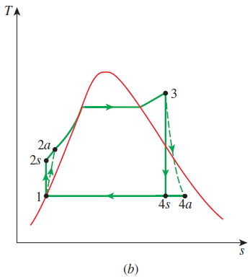
DEVIATION OF ACTUAL VAPOR POWER CYCLES FROM IDEALIZED ONES
The actual vapor power cycle differs from the ideal Rankine cycle as a result of irreversibilities in various components.
Fluid friction and heat loss to the surroundings are the two common sources of irreversibilities.
Isentropic efficiencies
(a) Deviation of actual vapor power cycle from the ideal Rankine cycle. (b) The effect of pump and turbine irreversibilities on the ideal Rankine cycle.

Slide 47

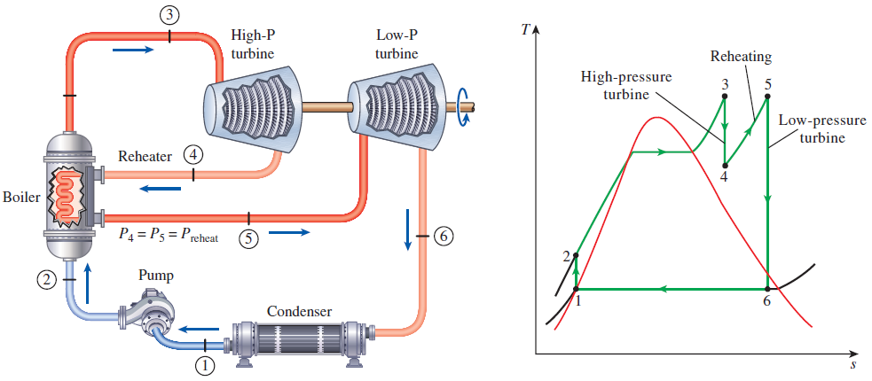
THE IDEAL REHEAT RANKINE CYCLE
How can we take advantage of the increased efficiencies at higher boiler pressures without facing the problem of excessive moisture at the final stages of the turbine?
1. Superheat the steam to very high temperatures. It is limited metallurgically.
2. Expand the steam in the turbine in two stages, and reheat it in between (reheat)

Slide 48
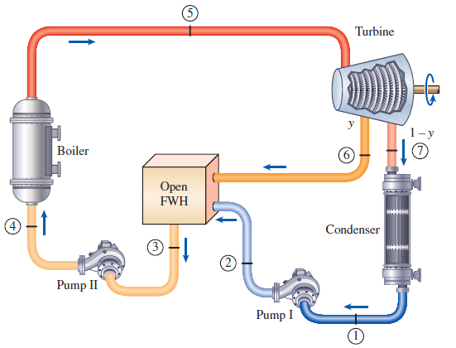
THE IDEAL REGENERATIVE RANKINE CYCLE
An open (or direct-contact) feedwater heater is basically a mixing chamber, where the steam extracted from the turbine mixes with the feedwater exiting the pump. Ideally, the mixture leaves the heater as a saturated liquid at the heater pressure.

Slide 49
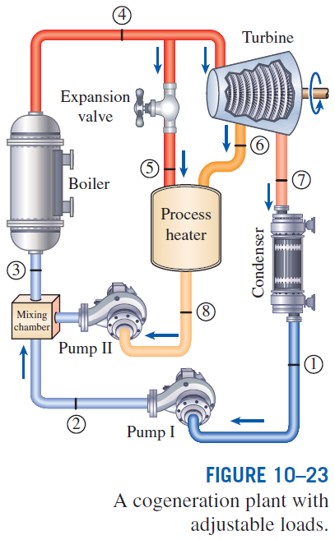
COGENERATION
Many industries require energy input in the form of heat, called process heat. Process heat in these industries is usually supplied by steam at 5 to 7 atm and 150 to 200°C. Energy is usually transferred to the steam by burning coal, oil, natural gas, or another fuel in a furnace.
Industries that use large amounts of process heat also consume a large amount of electric power.
It makes sense to use the already-existing work potential to produce power instead of letting it go to waste.
The result is a plant that produces electricity while meeting the process-heat requirements of certain industrial processes (cogeneration plant)
Cogeneration: The production of more than one useful form of energy (such as process heat and electric power) from the same energy source.

Slide 50


Utilization factor
Actual cogeneration plants have utilization factors as high as 80%.

Slide 51
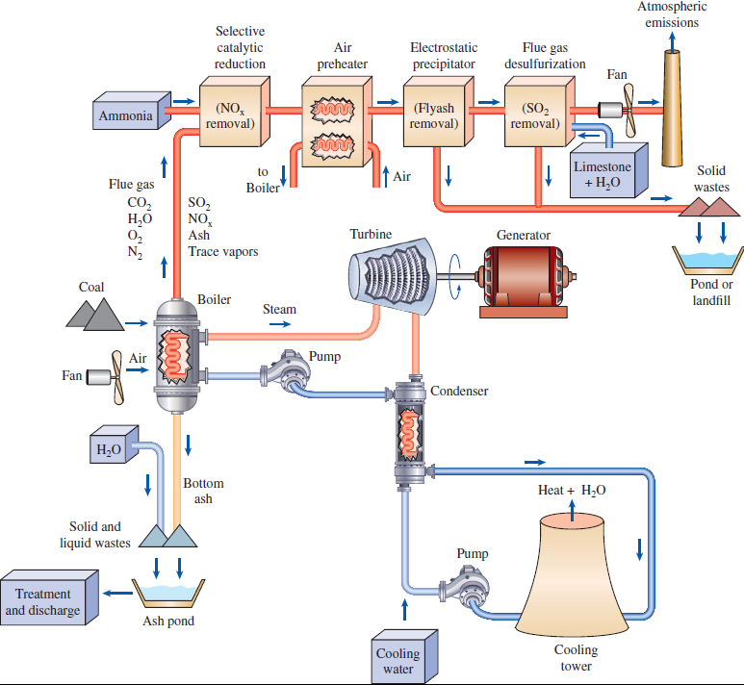
Schematic diagram of a coal-fired power plant with environmental controls for major pollutants

Slide 52
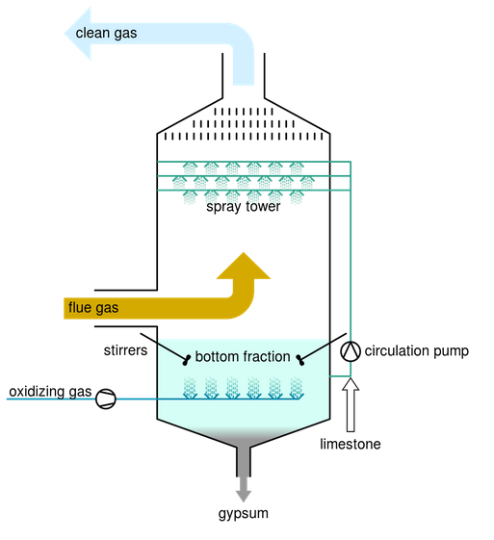
Flue gas desulfurization (FGD)
Flue gas desulfurization (FGD): All coal-fired power plants must be equipped with FGD systems, which are very effective in SO₂ removal.
In this process, a slurry of pulverized limestone (calcium carbonate—CaCO₃) mixed with water is used. The process takes place in a vessel called scrubber.
A mixture of limestone and water is sprayed into the combustion gas containing SO₂ according to the reaction:
The product gypsum (CaSO₄ ⋅ 2H₂O) has commercial value as it is a main constituent in plaster, blackboard chalk, and wallboard.
FGD effectiveness: A modern flue gas desulfurization system utilizing limestone (CaCO₃) can remove more than 95% of SO₂ in combustion gases.

Slide 53

Selective catalytic reduction (SCR)
In coal-fired power plants, a SCR unit is installed into the combustion gas stream right after the boiler.
The system uses a catalyst material to promote the conversion of NO_{x} components into non-harmful molecular nitrogen N₂.
Ammonia (NH₃) is also injected into the combustion gas stream leading to the following reactions
Temperature requirement for SCR: These reactions require a temperature of about 400°C, and this is the reason the SCR system is installed right after the boiler of the power plant.
Effectiveness of SCR: The SCR systems can typically remove 70 to 90% of NO_{x} in the combustion gases.

Slide 54
COMBINED GAS–VAPOR POWER CYCLES
The continued quest for higher thermal efficiencies has resulted in rather innovative modifications to conventional power plants.
A popular modification involves a gas power cycle topping a vapor power cycle, which is called the combined gas–vapor cycle, or just the combined cycle.
The combined cycle of greatest interest is the gas-turbine (Brayton) cycle topping a steam-turbine (Rankine) cycle, which has a higher thermal efficiency than either of the cycles executed individually.
It makes engineering sense to take advantage of the very desirable characteristics of the gas-turbine cycle at high temperatures and to use the high-temperature exhaust gases as the energy source for the bottoming cycle such as a steam power cycle. The result is a combined gas–steam cycle.
Recent developments in gas-turbine technology have made the combined gas–steam cycle economically very attractive.
The combined cycle increases the efficiency without increasing the initial cost greatly. Consequently, many new power plants operate on combined cycles, and many more existing steam- or gas-turbine plants are being converted to combined-cycle power plants.
Thermal efficiencies over 50% are reported.

Slide 55
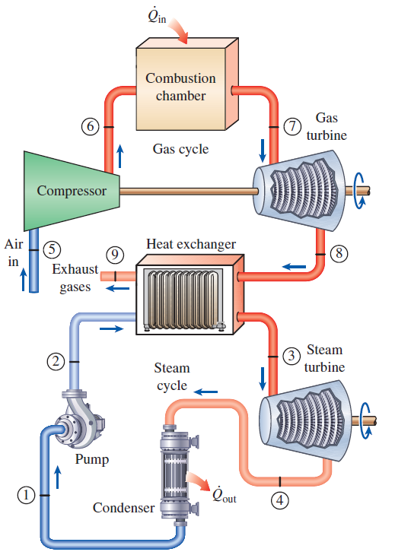
COMBINED GAS–VAPOR POWER CYCLES

